Slide 1


Social Buzz

Slide 2


Today's agenda
Project recap
Problem
The Analytics team
Process
Insights
Summary

Slide 3


Project Recap
Social Buzz, explosive social platform with 500M users, needs help managing its massive data and preparing for IPO.
Seeking advisory firm for scaling, big data expertise, and IPO guidance.
Initial project includes data audit, top content analysis, and showcasing relevant client success stories. All to prove expertise and become their trusted advisor.

Slide 4


Problem
Over 100000 posts per day
36.500.000 peices of content per year
But how to capitalize on it when there is so much?
Analysis to find Social Buzz’s top 5 most popular categories of content

Slide 5



Andres Fleming
Chief Technical Architect
The Analytics team
Marcus Rompton
Senior Principle
Hajar Nechbaoui
Data analyst

Slide 6

Process
1
Data Understunding
2
Data Cleaning
3
Data Modelling
4
Data analysis
5
Uncover Insights

Slide 7


Insights
How many unique categories are there?
How many reactions are there to the most popular category?
What was the month with the most posts?
What is the top 5 content categories?

Slide 8
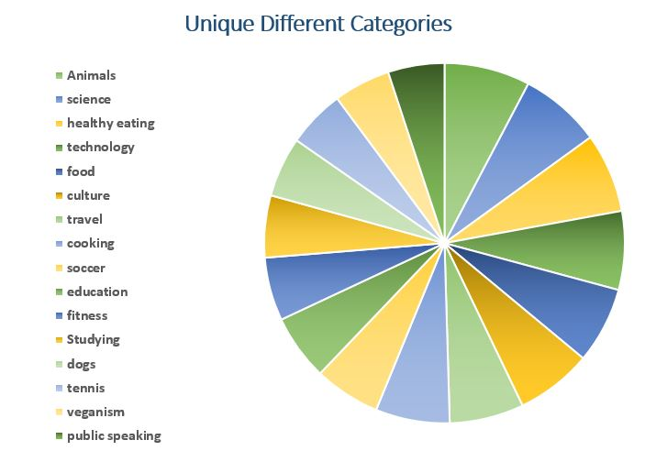

Slide 9
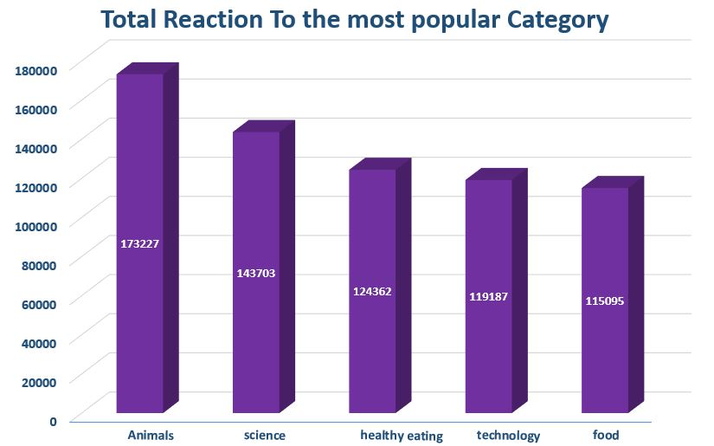

Slide 10
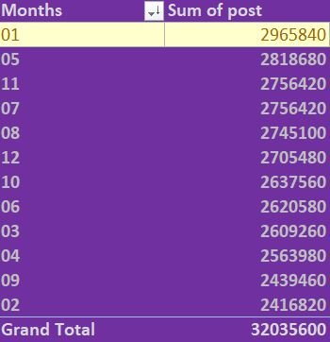

Slide 11
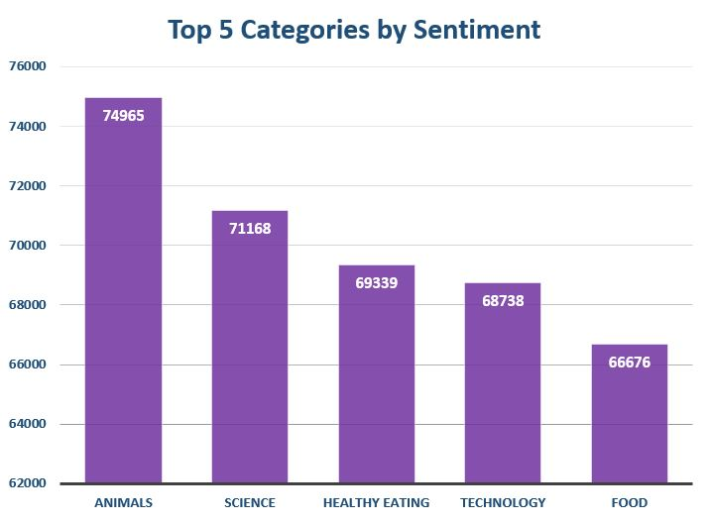

Slide 12


The top 5 categories are: Animal,Science,Healthyeating,Technology,Food.
Summary
Animals and science are the two most popular categories of content.
January was the month with the most posts .

Slide 13

Thank you!

